Slide 1
NATURAL LANGUAGE PROCESSING
PROJECT DONE BY,
1. Sreelekshmi J
2. Niroshini M
3. Mohammed Arshad
4. Mohammed Suhail P K
5. Tanmay Mandalay
6. Nayuni Ramani
7. Salman M
UNDER THE GUIDANCE OF,
Karthik

Slide 2
INTRODUCTION
Most of the people are expressing their view by posting it on social platforms about a product. We need to understand the liking or disliking of that product to help the organization to make some decisions about the production and supply of the same in the market. So here consider extracting reviews from any social platform or from ecommerce websites ‘Amazon.com’ and analyze them to satisfy the object.
“Consumer Data Will be the biggest differentiator in the next two to three years, Whoever unlocks the reams of data and uses it strategically will win”

Slide 3
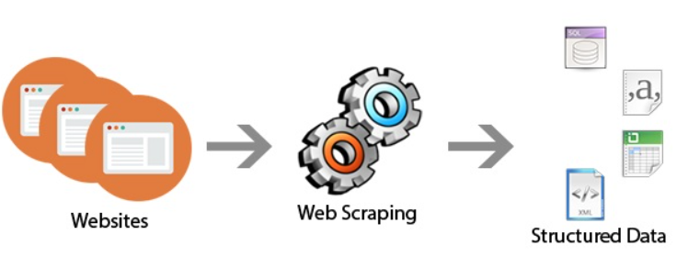
WEB SCRAPING

Slide 4
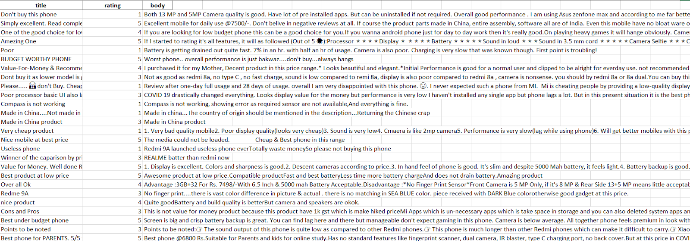
SOURCE
LIBRARIES
PRODUCT
REDMI 9A
PANDAS
NUMPY
BEAUTIFULSOUP
REQUESTS
AMAZON.COM

Slide 5
Project flowchart
Scrapped the data from Amazon web
Exploratory data analysis and visualization
Pre-processing data
Apply NLP models on the data
Evaluate and compare the model performance
Finalize the model and Implement NLP system
Model deployment

Slide 6
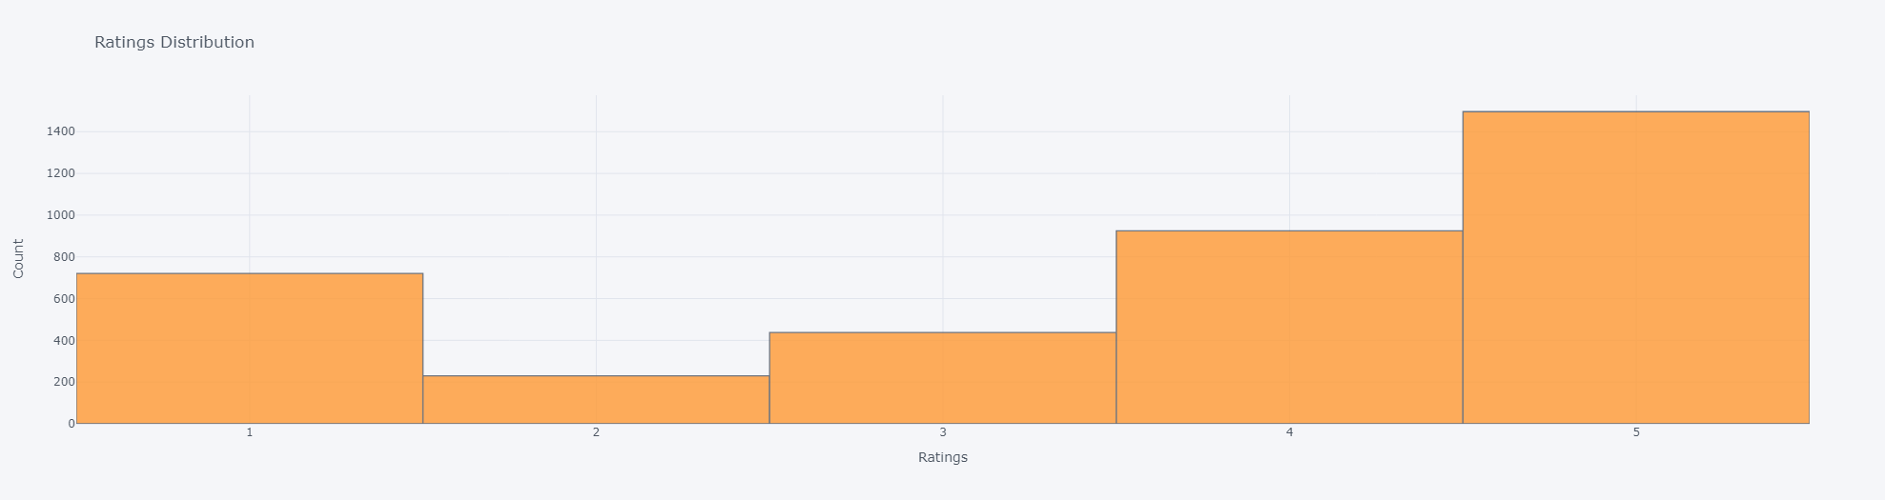
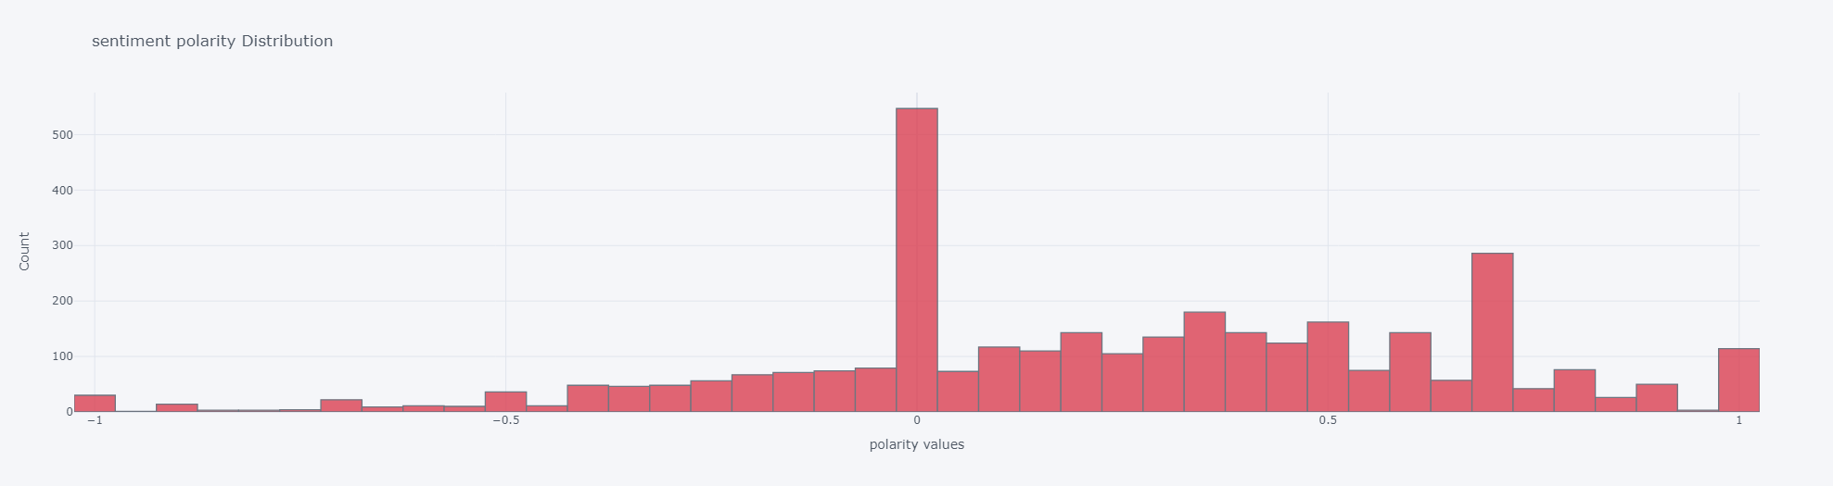
Exploratory data analysis
Review rating data distribution:
Sentiment polarity distribution:

Slide 7
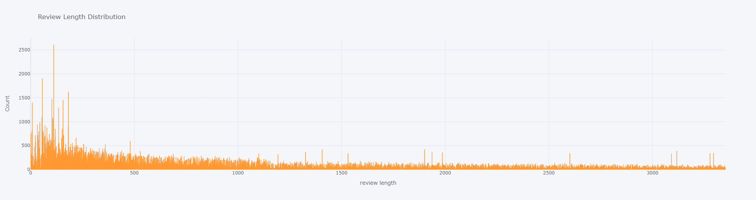
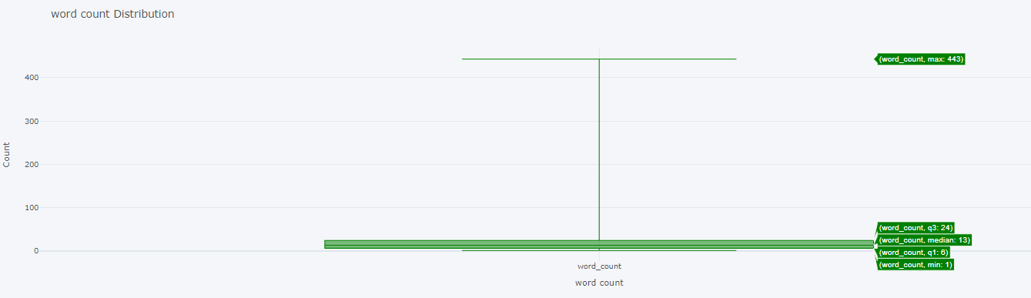
Exploratory data analysis
Review length distribution:
Word count distribution:

Slide 8
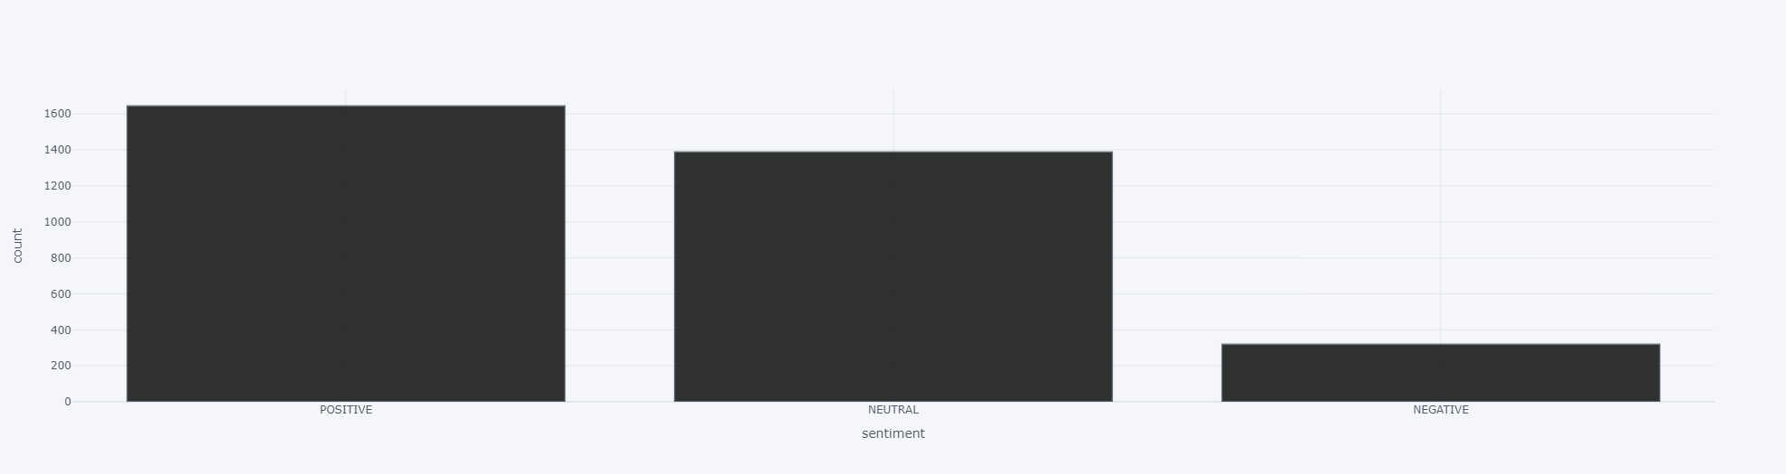
Exploratory data analysis
Review sentiment analysis graph:

Slide 9
PREPROCESSING STEPS
Removing Emojis, Special characters, URLs, Multiple spaces, hashtags
Normalizing the text
Tokenization
Removing Stopwords
Stemming/Lemmatization

Slide 10
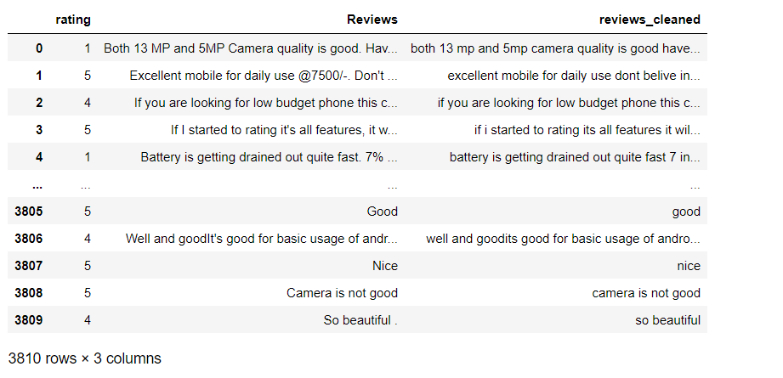
Data post pre-processing
Cleaned Data

Slide 11
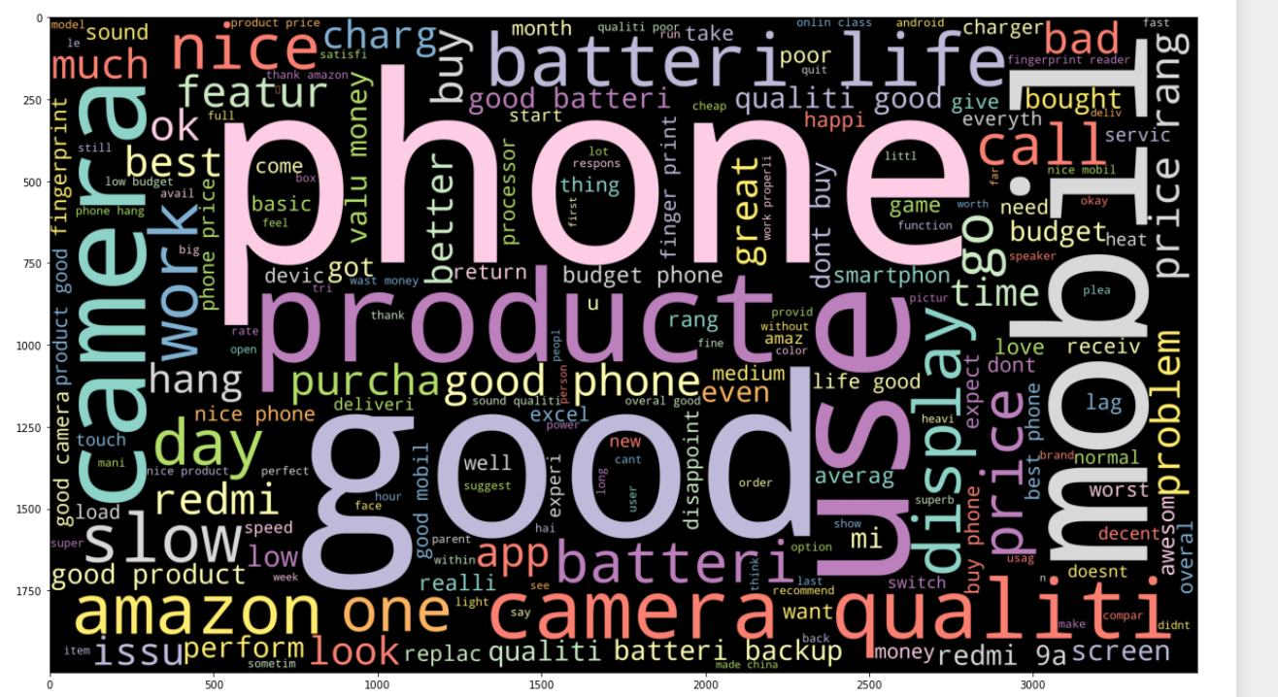
Word Cloud for representing of reviews

Slide 12
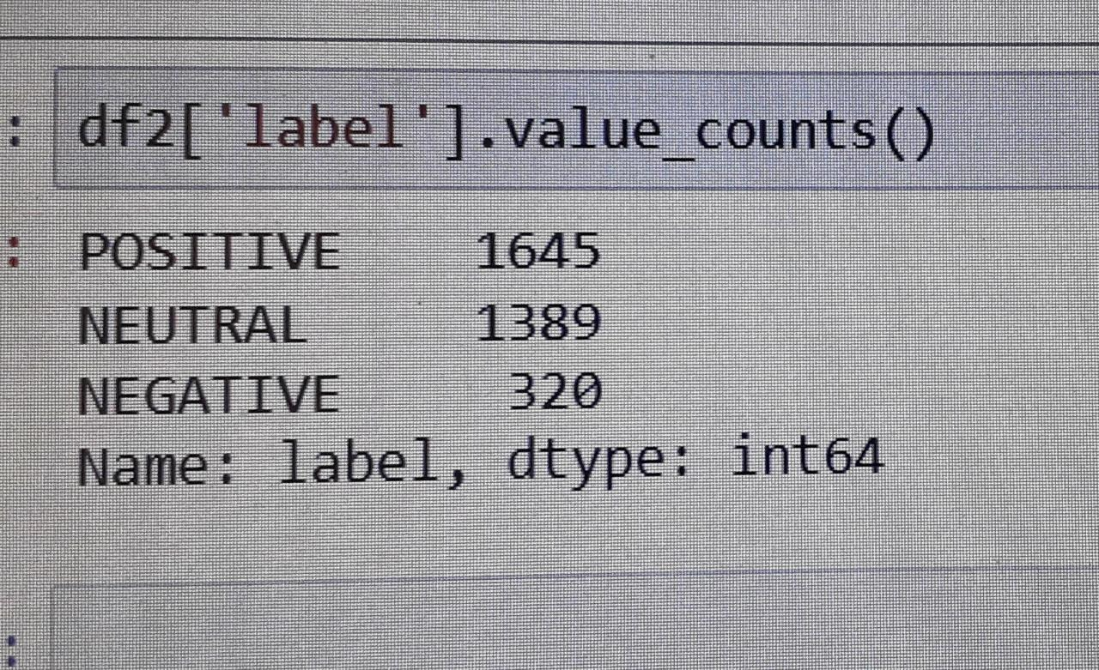
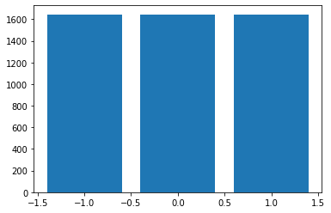
Imbalance data
SMOTE (Synthetic Minority Oversampling Technique) – Oversampling
SMOTE (synthetic minority oversampling technique) is one of the most commonly used oversampling methods to solve the imbalance problem. It aims to balance class distribution by randomly increasing minority class
After Balancing, data will be like this:

Slide 13
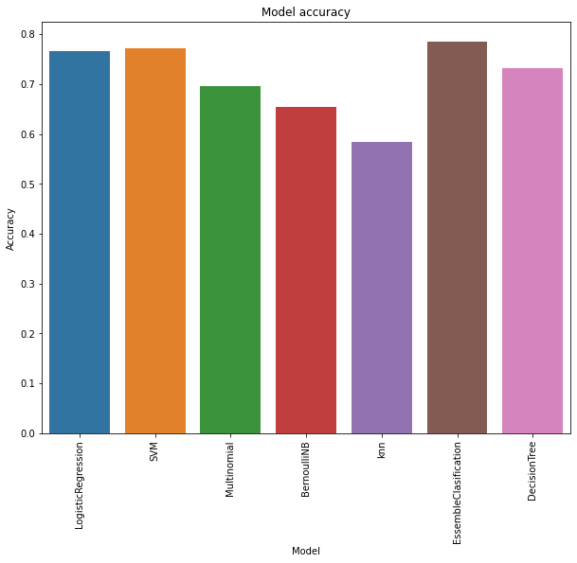
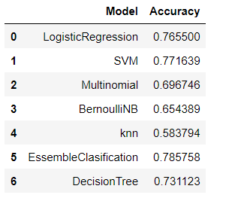
MODEL BUILDING
Logistic Regression
SVM
Naive Bayes
k -NN classifier
RandomForest
Decision Tree

Slide 14


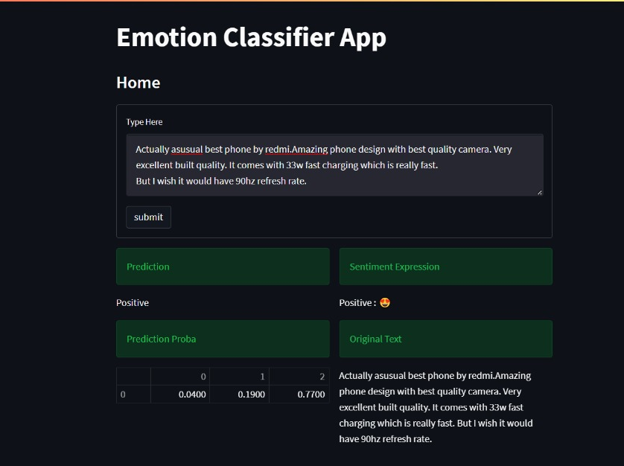
MODEL DEPLOYEMENT

Slide 15
Challenges faced:
Scrapping multiple pages data from the website
Balancing the imbalanced data
How do we overcome:
Using multiple online available codes and brainstorming
oversample the data and used Smote(Synthetic Minority Oversampling Technique)

Slide 16
Thank you

